Slide 1
System of Education in Hungary
In the 21th Century

Slide 2
Hungarian Education & Training System

Slide 3
Maintenance
Owners and Maintainers
Before 2013 the owners and the maintainers of schools were the municipalities
From 2013 the main maintainer is the Government
Klebelsberg Intézményfenntartó Központ - KLIK is the maintainer institution
From 2015 the maintenaner of vocational and training schools is the Ministry of Economy.

Slide 4
Learning is free of charge
Public education is free of charge
The first profession is free of charge
The second profession is free of charge in adult trainee form
The first higher education degree is free of charge (if there are enough places and the student’s admission score is high enough)

Slide 5
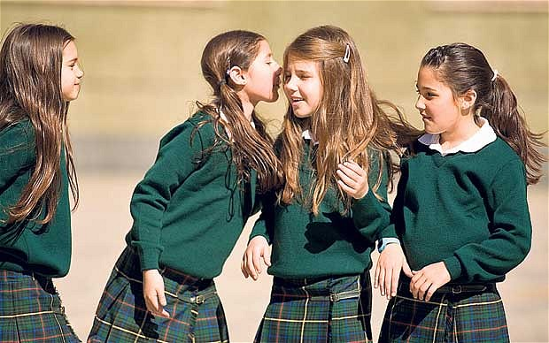
There are more owners and maintainers (private schools)
The owners can be Churces, Foundations, Firms, etc.
They can ask for financial contribution from parents for extra services – trips, extra lessons, sport activities – but not for tuition (~ € 800 / year )
Professional training costs about €400 - €1000 / year
University or college studies vary from € 1000 to € 4000 / year or more, the most expensive is the university of medicine

Slide 6
The number of students in Hungary in 2017
This year about 90 000 students in the 9th form
45% attend grammar schools
35% attend vocational secondary schools
20% attend vocational schools (apprenticeship)

Slide 7
The Hungarian Education System
The school year consists of 182 days of teaching, and begins on 1st September
Education is compulsory up to the age of 16
There are three school breaks in autumn, in winter and in spring with 10 – 11 week summer break.
There are five working days every week
Teaching lessons usually last 45 minutes
Workshop activities are 60 minutes long

Slide 8
The Hungarian Education System
The average group size in kindergarten is 22
Depending on the type of school the minimum class size is 25-28 in the beginning
Pupils are assessed by teachers throughout the school year with oral, written tests and practical work and they are given grades (scale 1-5)
1 – Insufficient ( 0 - 50% )
2 – Sufficient (50-60%)
3 – Medium (60-70%)
4 – Good (70-85%)
5 – Excellent (85-100%)

Slide 9
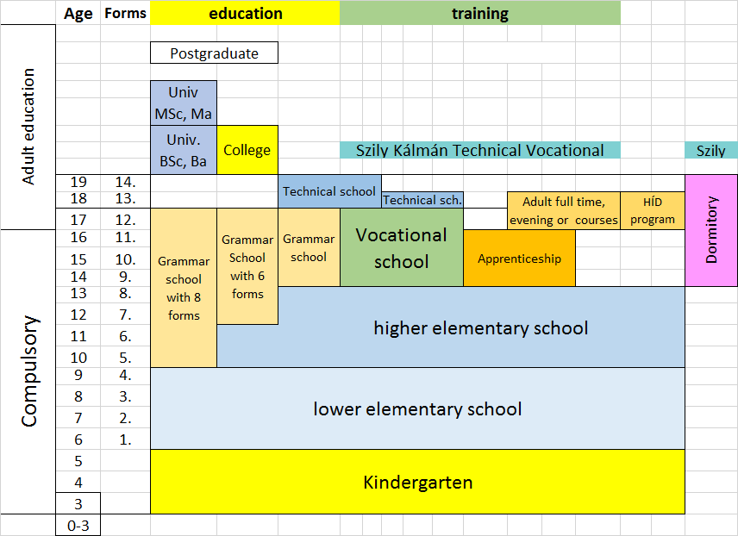

Slide 10
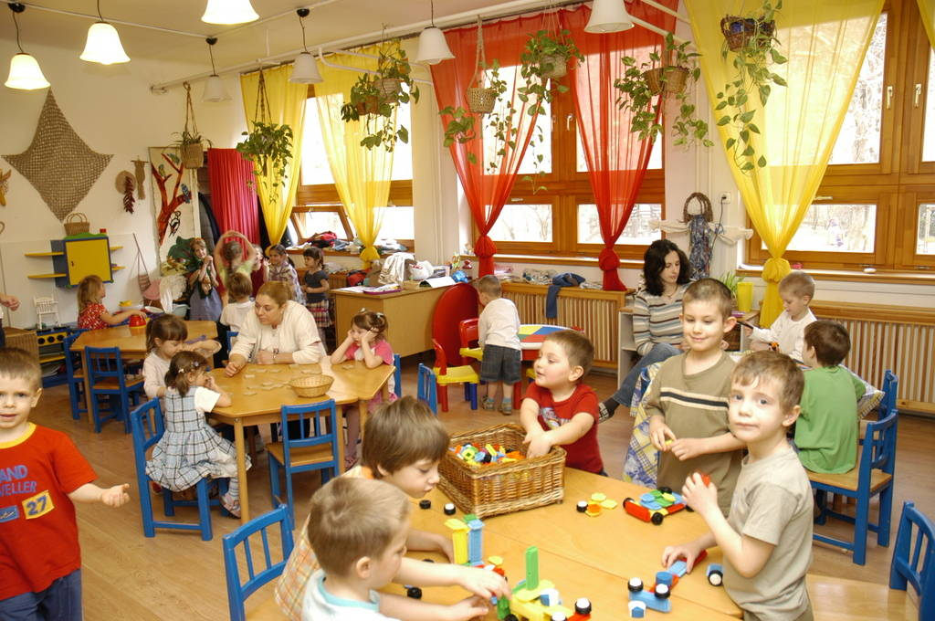
Kindergarten
Children from 3-6 years of age
It is compulsory from this year
Activities
Playful development
Improvement of mother tongue
”Learning throughout experience”
Socialisation

Slide 11
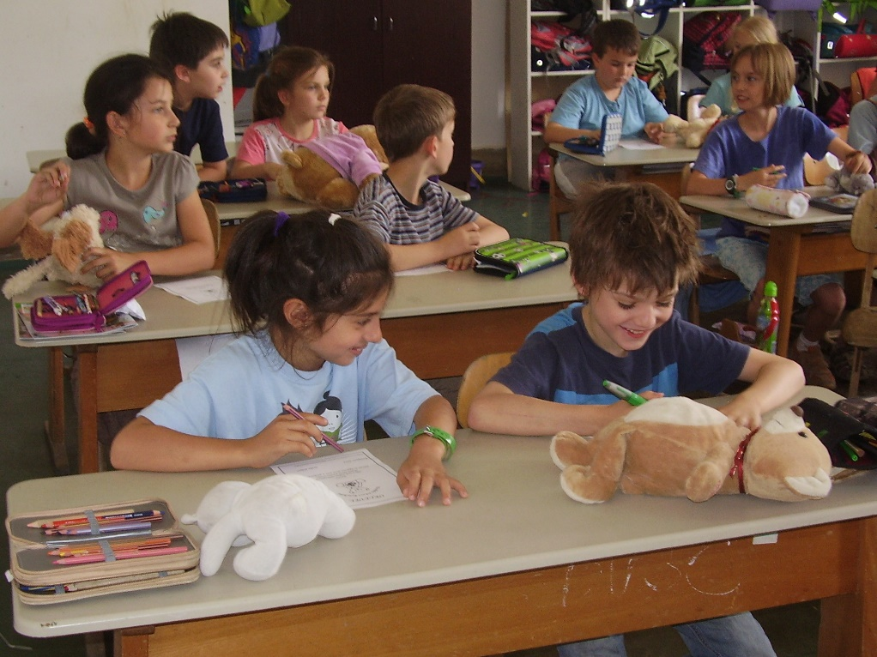
Lower elementary school
Compulsory by law for children between 6 and 16 years of age
It lasts 4, 6 or 8 years
Subjects include Literature, Grammar, Mathematics, Music, Art, Physical education, Environmental studies

Slide 12
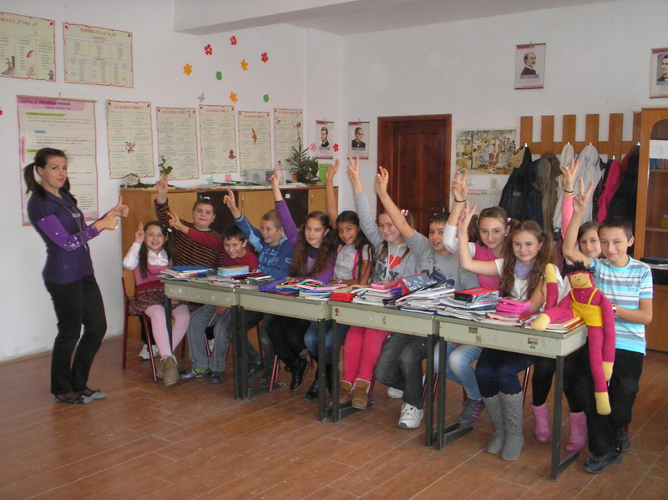
Higher elementary school
New subjects are: Biology, Geography, History, History of Art, Physics, Chemistry, one foreign language (mainly English or German)

Slide 13
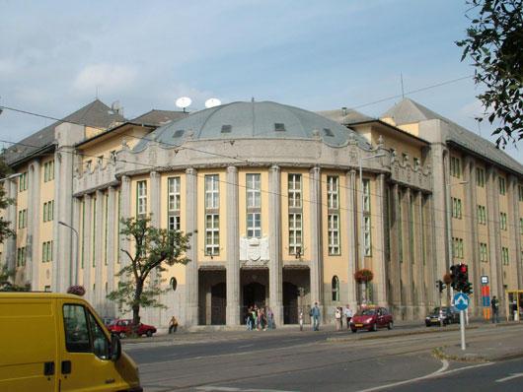
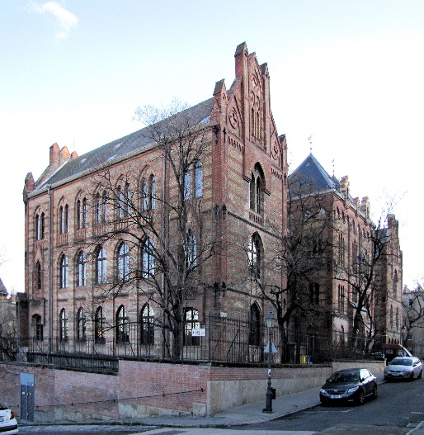
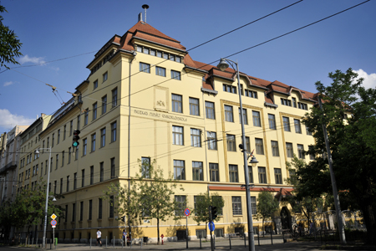
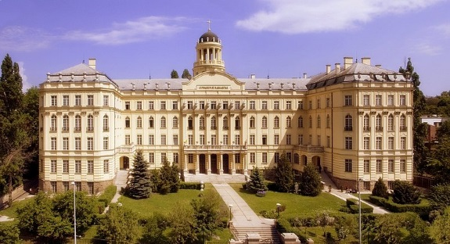
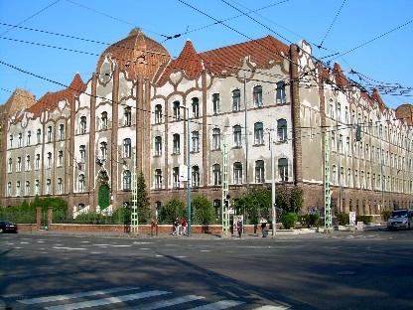
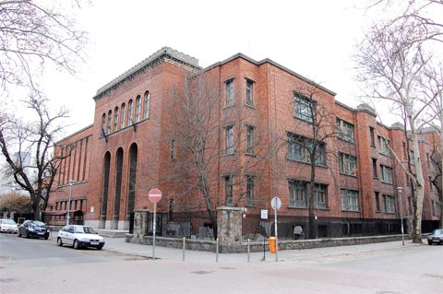
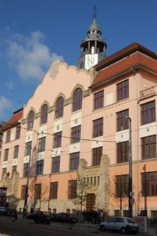
Secondary education – Grammar school
Usually lasts for 4 years but there are schools where these are 6 or 8 years
There is a school leaving exam (final exam)
The final exam consist of 5 subjects
Maths
Literature and Grammar
History
One foreign language
One subject at the student’s choice from studied subjects
The main goal is the gateway to universities or colleges
Hungarian famous Grammar schools in the pictures
Fazekas Mihály No.1.

Slide 14
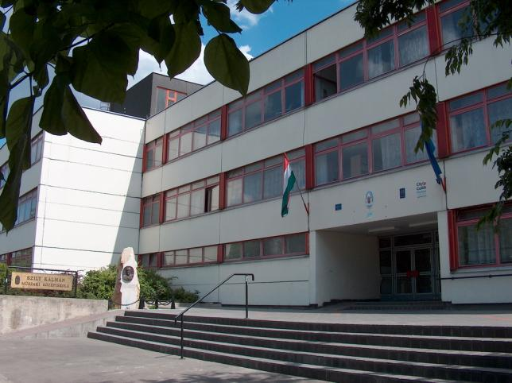
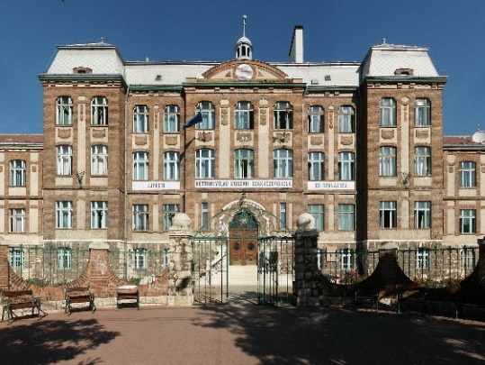
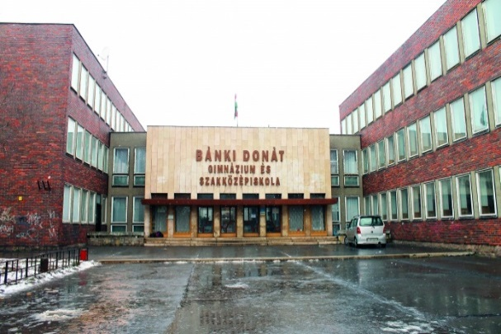
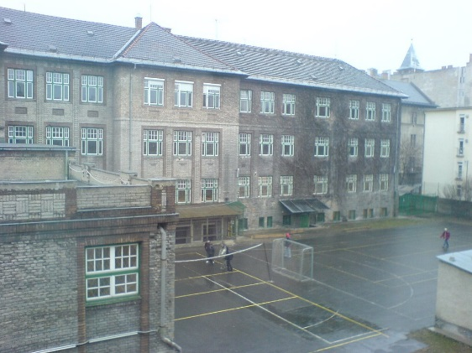
Secondary vocational school (Szakgimnázium)
Similar to grammar school but
There are professional subjects (about 30%)
Practical professional subjects
Theoretical professional subject
The fifth subject of the final exam is the professional one
The main goals
Continue studies in technical classes
They can go to university or college mainly in professional fields
Chance to get a job on the labour market

Slide 15
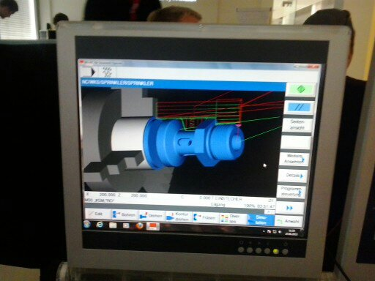
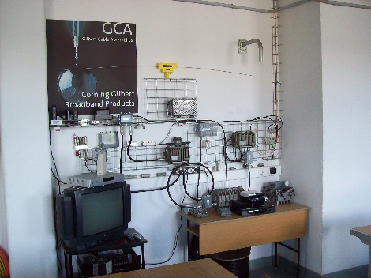
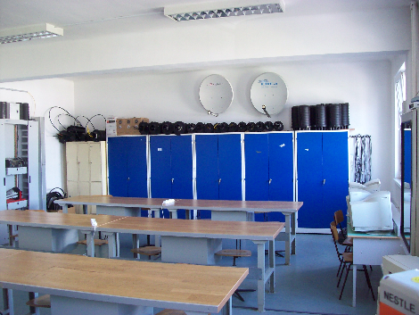
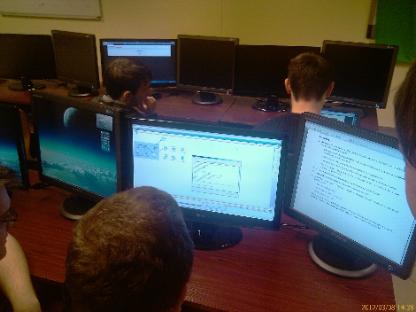
Technical school
If the student has a 4 year preliminary training in secondary school, vocational school studies last only one year, otherwise two years
The subjects are
professional subjects
30-40% theoretical subjects
60-70% practical subjects
Plus
Information technology
Foreign languages
The final exam consists of two parts of written, practical and oral parts
The goals are
Good chances on the labour market
Higher chance to continue studies at university or college

Slide 16
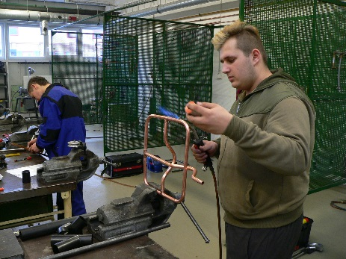
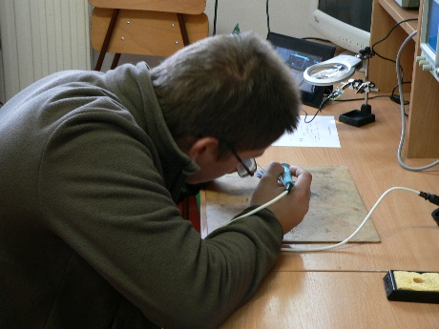
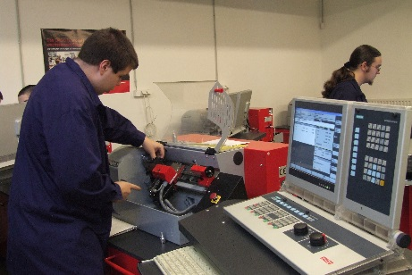
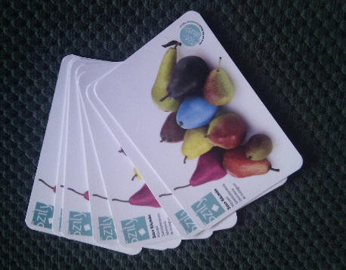
Apprenticeship
Takes 3 years after elementary school
In the 1st form there are some general subjects, but less lessons
From the 2nd form there are only professional subjects
60-70 % practical subjects
30-40 % theoretical subjects
The final exam consists of written, practical and oral parts
The main goal is to have a better choice on the labour market
The students can get scolarships in some professions (About €50 – 200 /month depending on academic results)
In the 2nd and 3rd form students can have workshops at private firms (Dual Training).

Slide 17
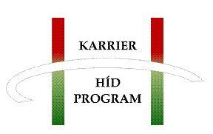
HÍD (bridge) programme
Designed for students of 16 who, for different reasons, do not finish elementary school. ☹
These students can take part in apprenticeship training
Only a few schools have this programme

Slide 18
Adult education / training
After elementary school or apprenticeship (from age 16)
Secondary vocational school without professional subjects
Only two years (11 and 12 forms)
The goal is final exam
After elementary school or apprenticeship (from age 16)
The goal is the first or the second profession
The second profession is paying
Adult education
Full time
Evening courses
Correspondence courses

Slide 19
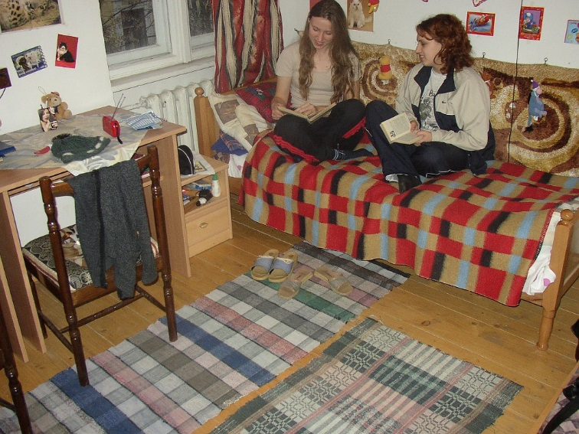
Dormitory
Dormitories are generally mixed but there are some only for girls or boys.
The age group 14 to 21
The resident has to learn in a secondary or vocational school
It is free of charge
There are afternoon preparation lessons and activities for the residents
There are educators who can help the students
There are leisure events for them
The educators are „parents substitutes”

Slide 20
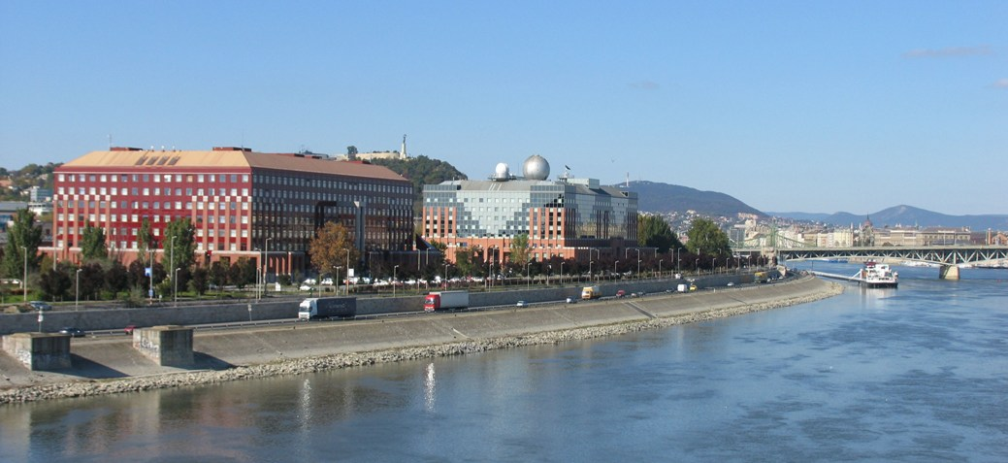
College or University
Higher education is divided between colleges and universities
College education lasts for 3 years (Ba, Bsc), university education 2 years after it (Ma, Msc)
Doctoral degree lasts for 2-3 years (Ph.D, Doct. Of Liberal Arts DLA)
There are 26 universities and 44 colleges in Hungary (Too many!)
Eötvös Lóránd University
on the banks of the Danube

Slide 21
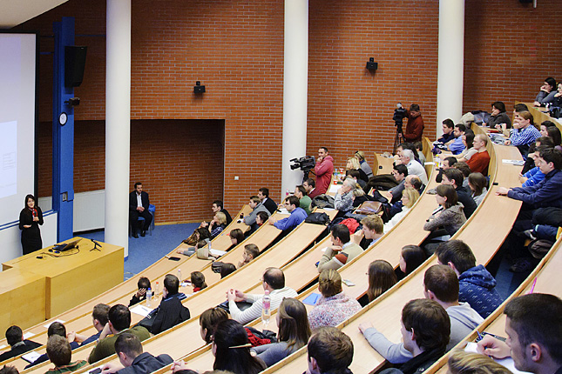
College or University
The academic year consists of two semesters ending with examination periods
Students must pass an intermediate level language exam to get their degree
From 2010 the student have to pass intermediate level language exam to input the College or University
There are free of charge places for first degree
The Government decides about the number of free of charge places every year
Students with high academic results who have high entrance scores can attend for free
The second degree is paying

Slide 22
Pedagogue’s career model
The pedagogue’s career system was introduced in 2013
The pedagogue can be classified:
Trainee – (0 – 2 years beginning of cereer)
Pedagogue I.
Pedagogue II.
Master Pedagogue
Researcher Pedagogue
Every pedagogue has to be classified in 9 years, and then can reach Pedagogue II. or Master Pedagogue
The Government decides about the number of classification procedures a year depending on the budget

Slide 23
Pedagogue’s career model
The pedagogues are the „Day Laborer of Nation” in Hungary.
The salary depends on
Classification (Pedagogue I. or II. etc.)
Years of employment
Teacher’s degree
Secondary school (instructors)
College (primary school teachers)
University level (secondary school teachers)
Teachers have 22-26 mandatory lessons per week.
The teachers’ average salary is little lower than average salary of intellectuals. The intellectuals’ average one is about € 700 now in Hungary!

Slide 24
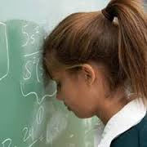
Problems, difficulties of education
Social problems affect education
The number of newborns has been decreasing in the last 30 years.
The results of PISA regarding Hungarian students have fallen back in the last 10 years.
There is a lack of motivation
Less students want to study in Apprenticeship
The number of college and university students in technical subjects is decreasing
Less and less foreign language exams

Slide 25
Conclusions
The Government regards educational policy as an essential tool for economic development, social cohesion and well-being.
Priorities:
The improvement of quality
Equal opportunities must be provided for everyone through education
Focus on vocational education

